Slide 1
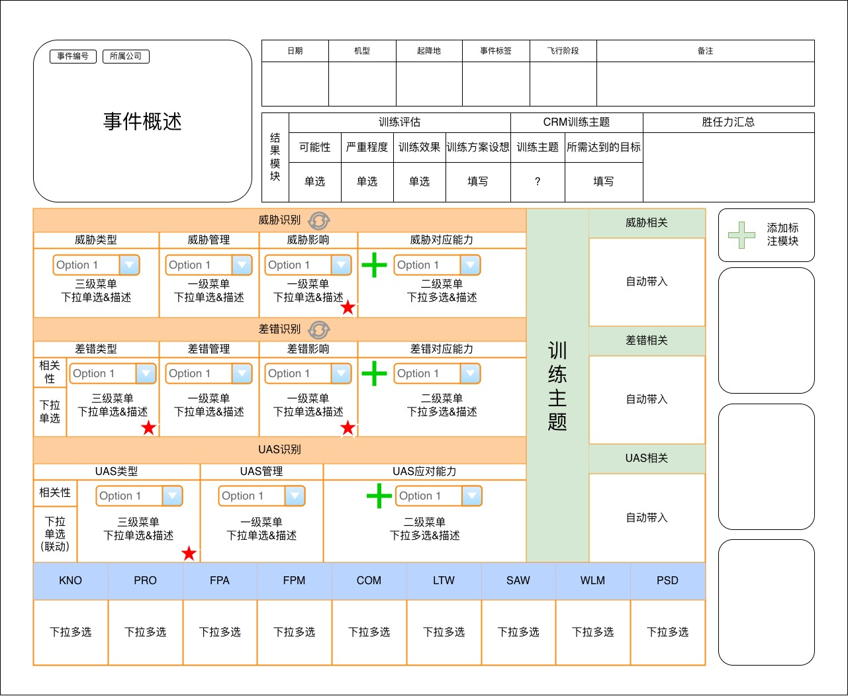
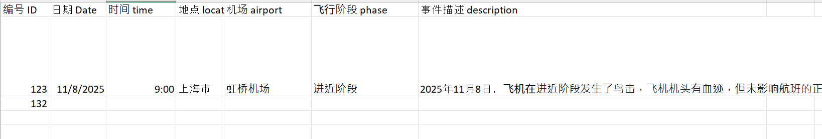
Read in from an excel file row
Ignore
User must manually fill
This is filled automatically based on user’s selection in the orange boxes. (there is a simple rule-base mapping)
User must click and select from a drop down menu or a pop up page/ pop up canvas.

Slide 2
Event ID
Company
Date
Plane Type
Plane take off and land plance
Event Label
Flight Phase
Comments
Event Abstract
Training Evaluation
CRM Training Theme
Summary
Result Module
Possibility
Severity
Training Effect
Training Plan
Training Theme
Reached Target
Single selection
Single selection
Single selection
User to Fill
?
User to Fill
Ignore
This
Options from the excel table
Options from the excel table
Options from the excel table
Options from the excel table
Relevancy
Select Single Value from the option
Options from the excel table
Options from the excel table
Options from the excel table
Options from the excel table
Relevancy
Select Single Value from the option
Options from the excel table
Options from the excel table
Options from the excel table
Options from the excel table
Options from the excel table
Options from the excel table
Options from the excel table
Options from the excel table
Options from the excel table
Options from the excel table
Options from the excel table
Options from the excel table

Slide 3
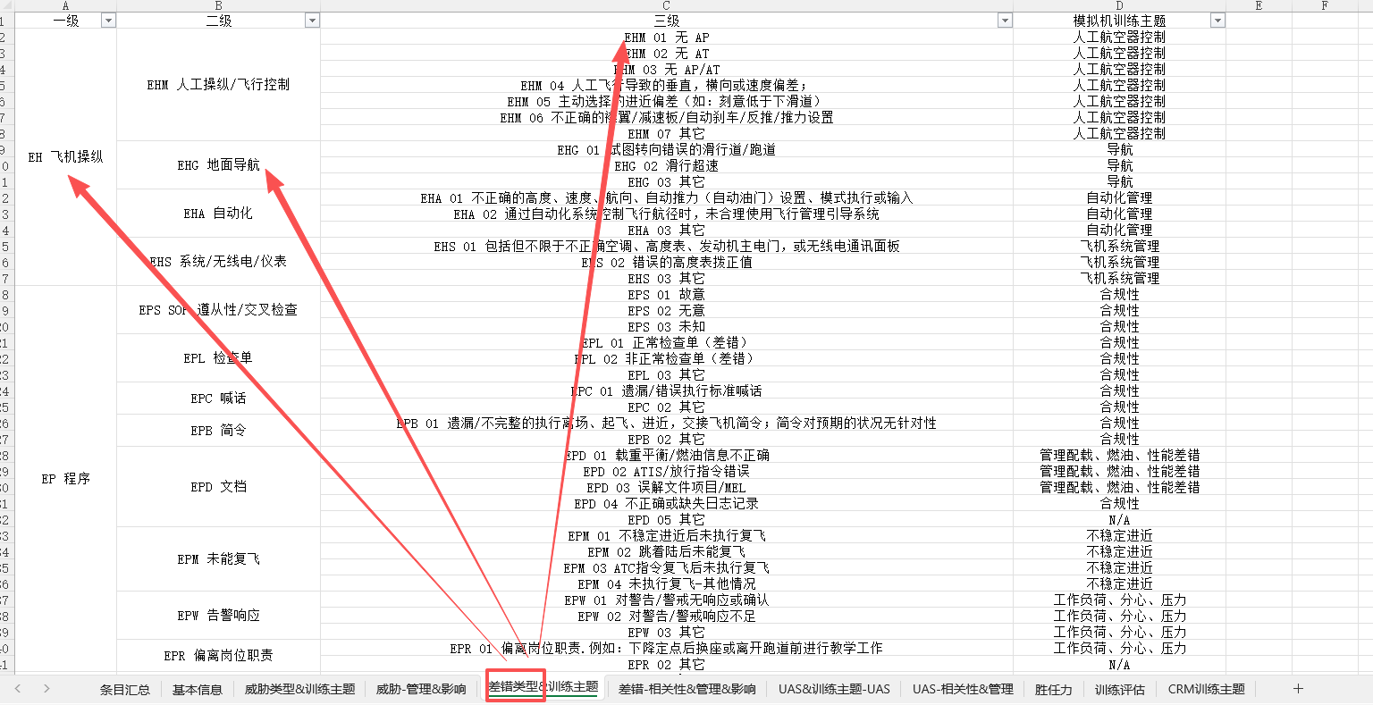
So, this drop down list, Chinese character is “差错类型”. And it can be found from the excel list. You can see 3 columns are pointed to in the figure. The first column is level 1, second is level 2, and third is level 3. Each level of selection contains several number of selection in the next level. That’s why I suggest using a sperate window for this selection. The others can be found by the same way.
Example for how to fine the value field for each drop down list :

Slide 4
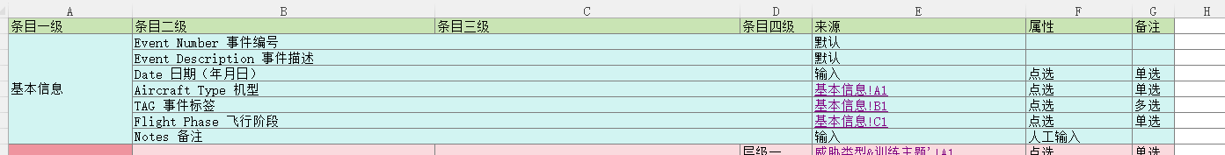
Mostly
Provided by an excel with these columns and should be auto filled

